Slide 1
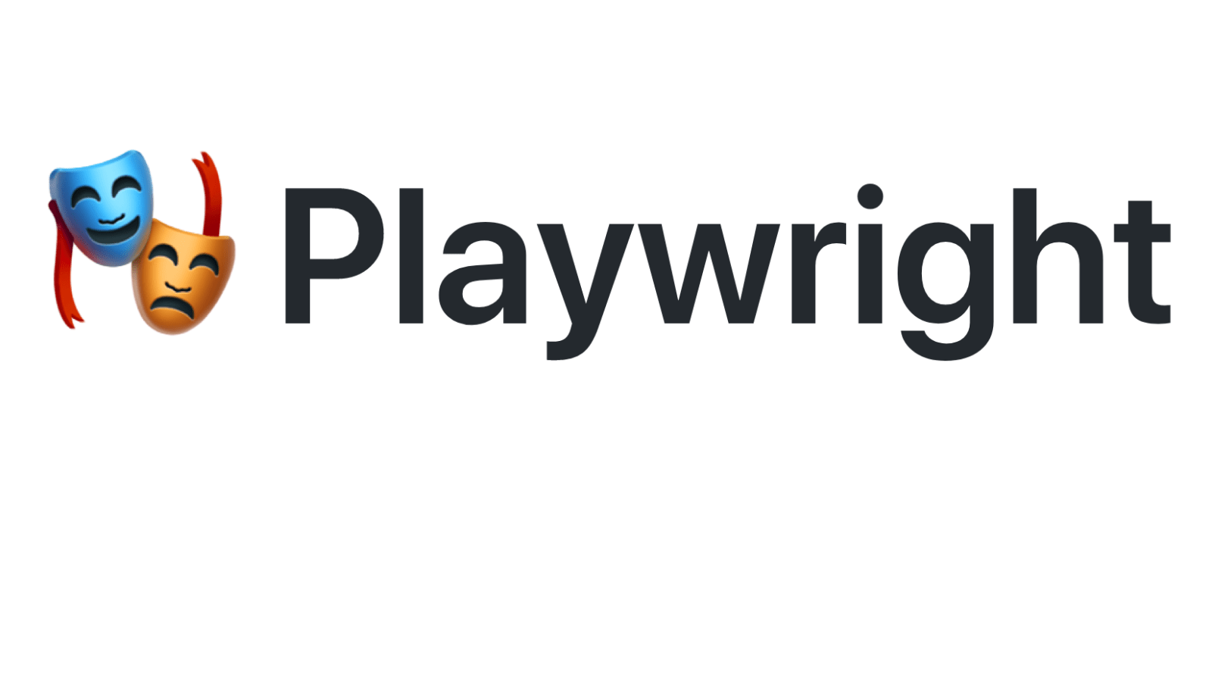


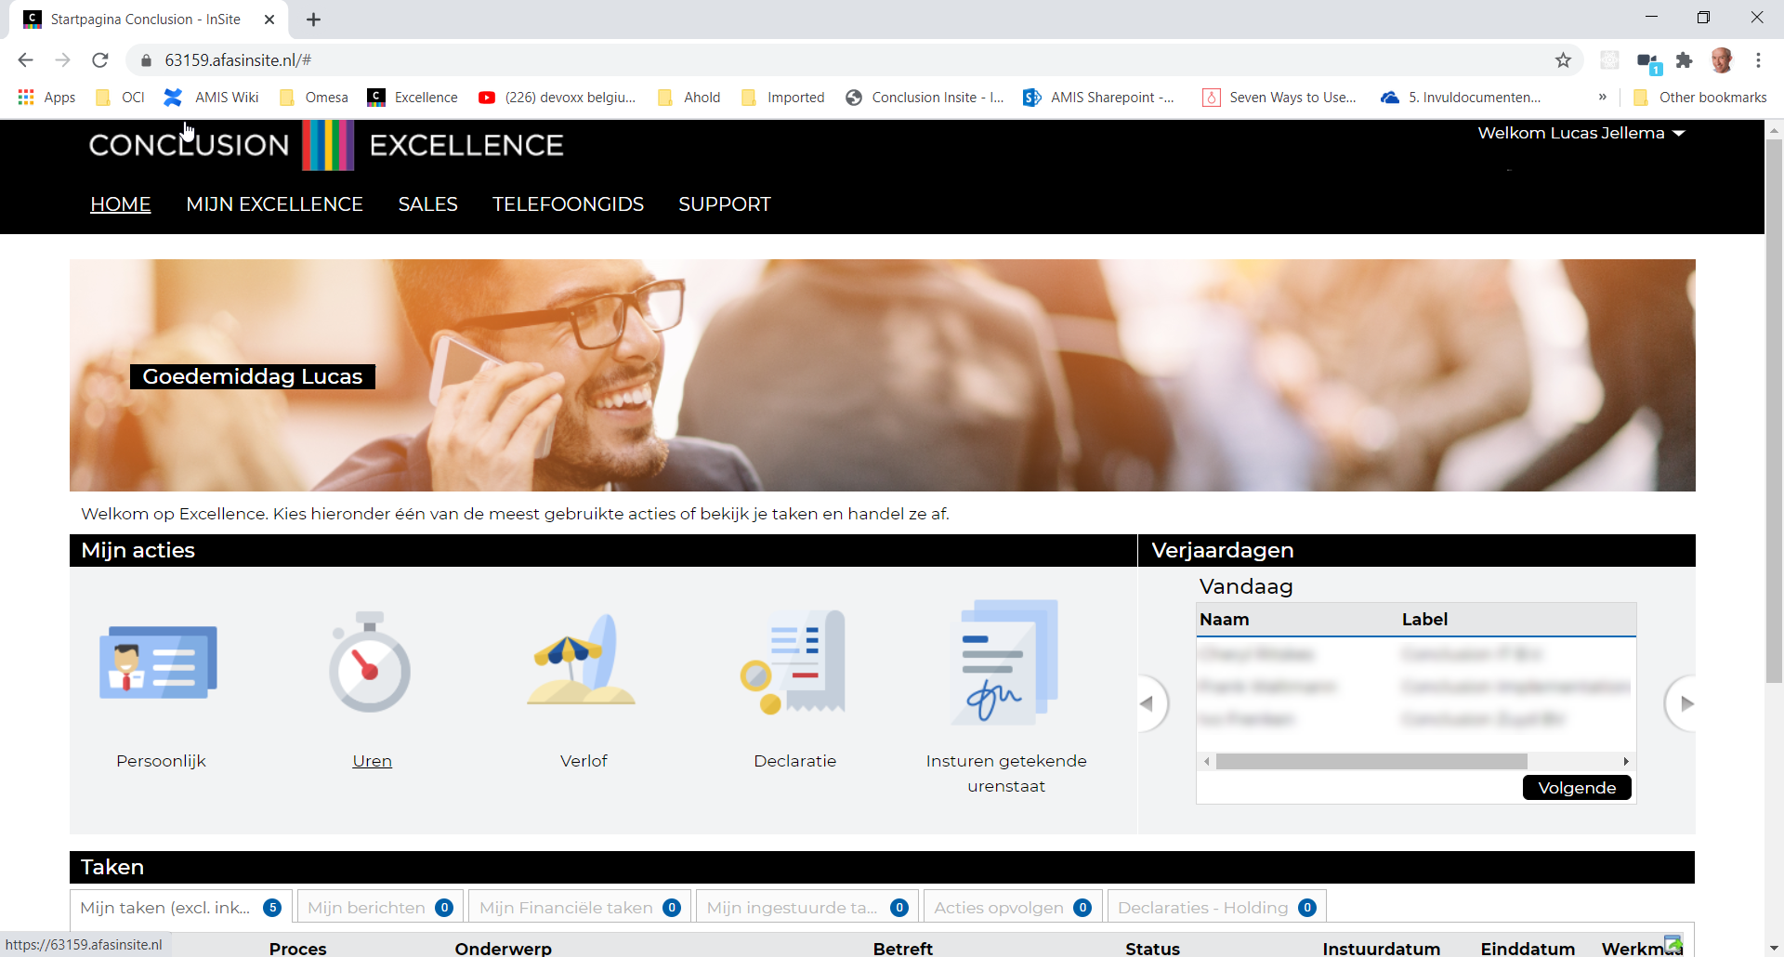



Playwright Automation of browser interaction
MeetUp | Code Café | Toolshed – 14 January 2021
Lucas Jellema, CTO & Architect AMIS | Conclusion
Workshop: bit.ly/pw-14jan

Slide 2





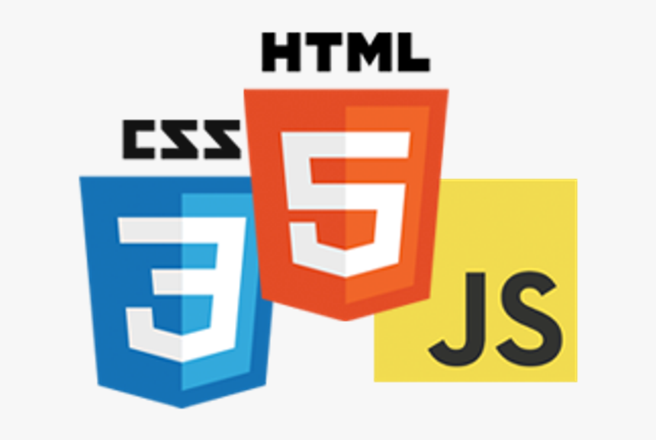


Lucas Jellema CTO for AMIS | Conclusion Solution Architect Programmer
lucas.jellema@amis.nl | technology.amis.nl | @lucasjellema | lucas-jellema

Slide 3
TL;DR if you are a programmer and do any work at all with web browsers, this session can change your professional life. If you do web development, integration, data engineering, DevOps automation, test engineering, then make sure to attend this session. (if you are a designer or solution architect – you need to be aware as well)

Slide 4
Summary

Slide 5
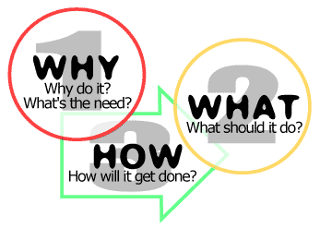

Agenda
Workshop: bit.ly/pw-14jan

Slide 6

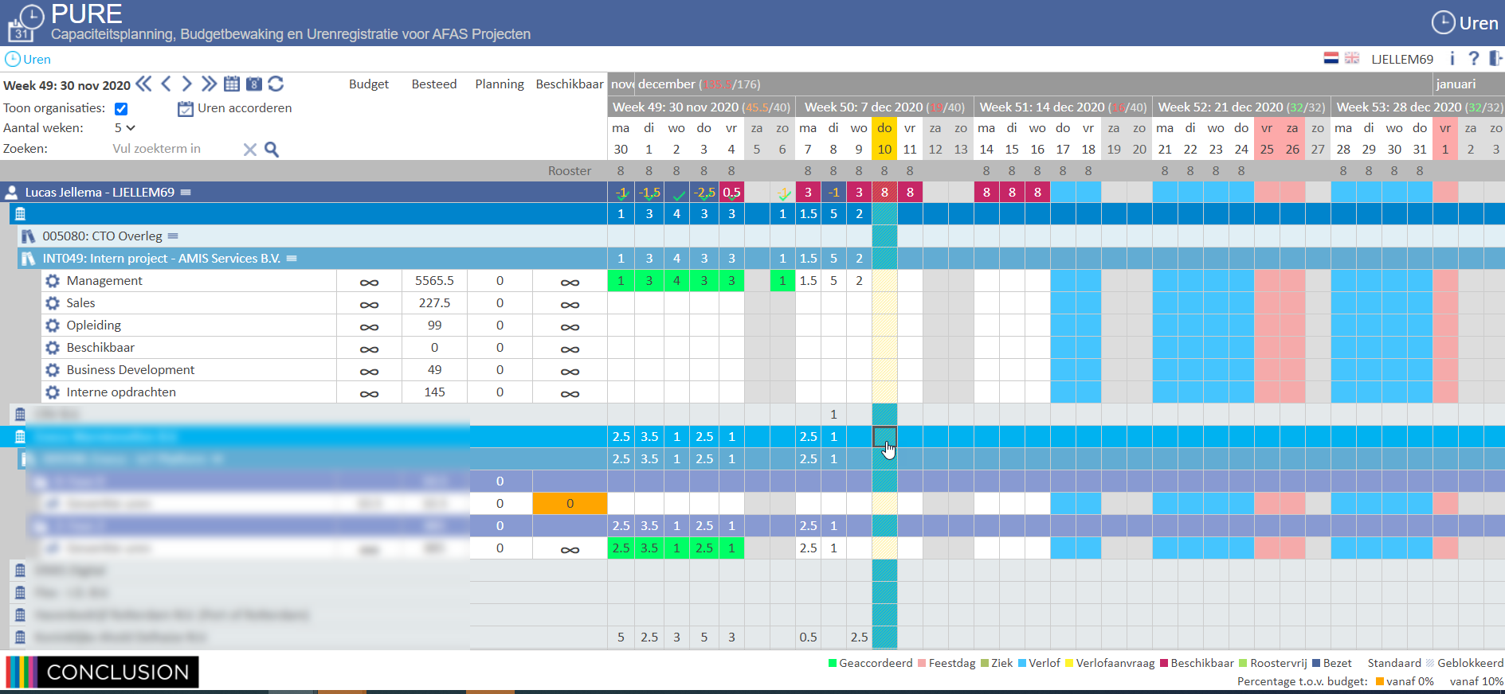
(the road into the) Timesheet Application

Slide 7
(the road into the) Timesheet Application

Slide 8
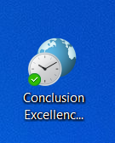
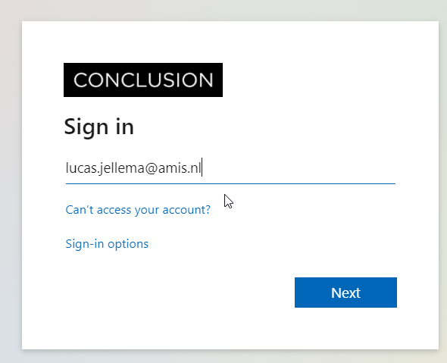
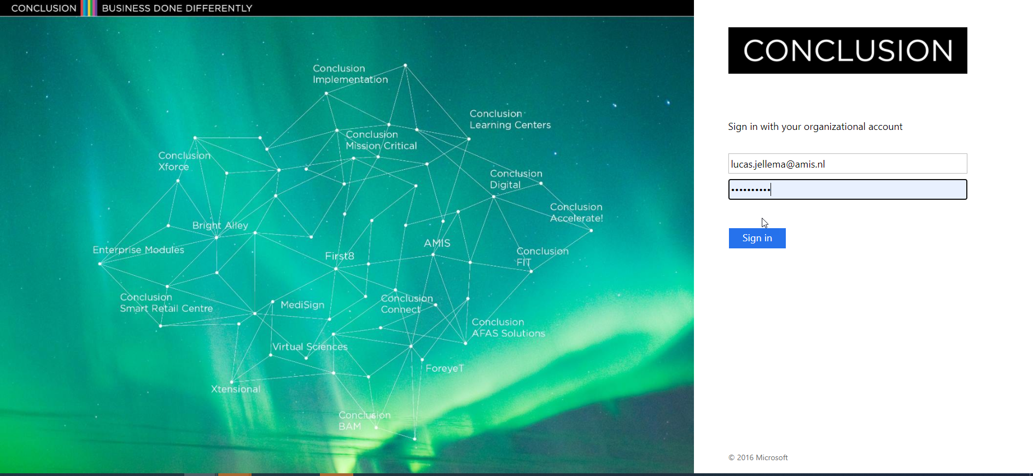
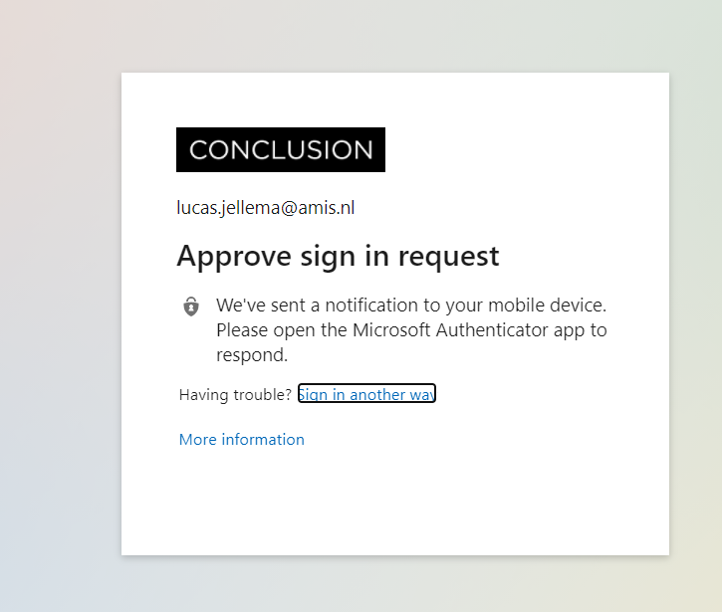
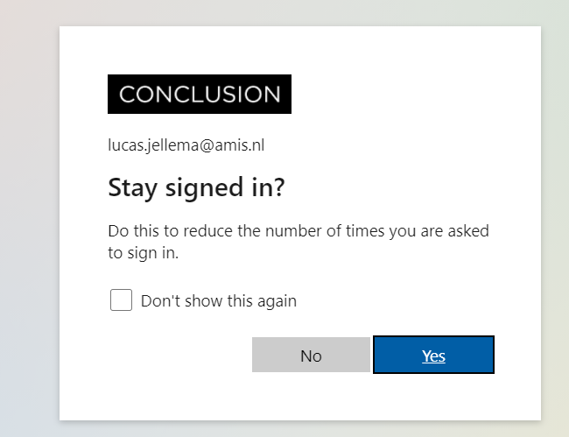
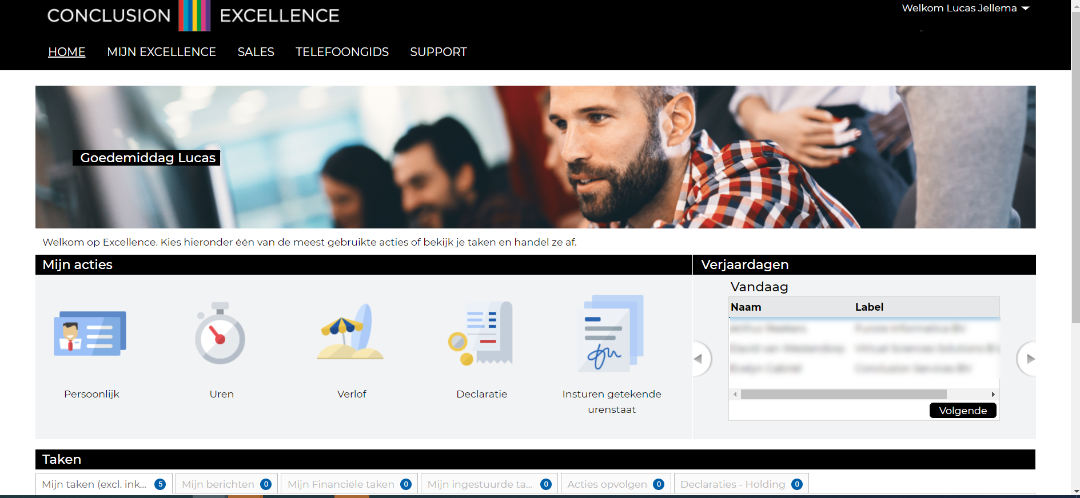
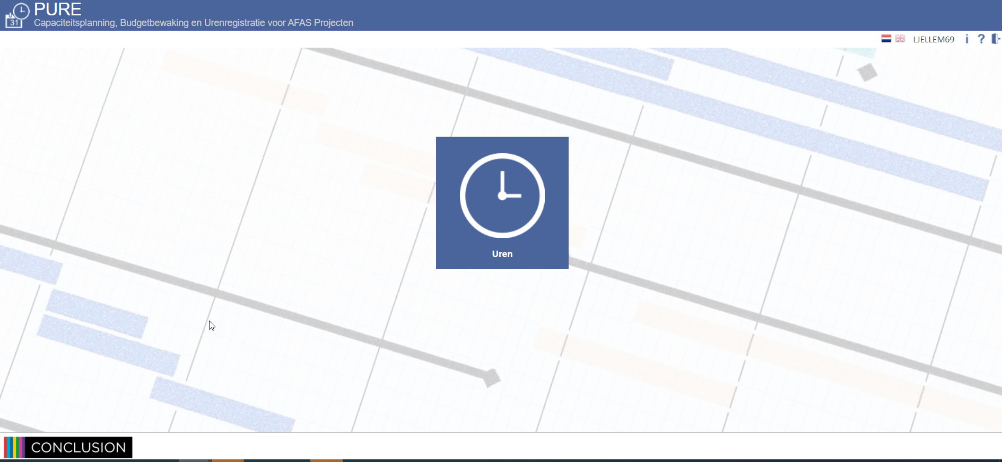
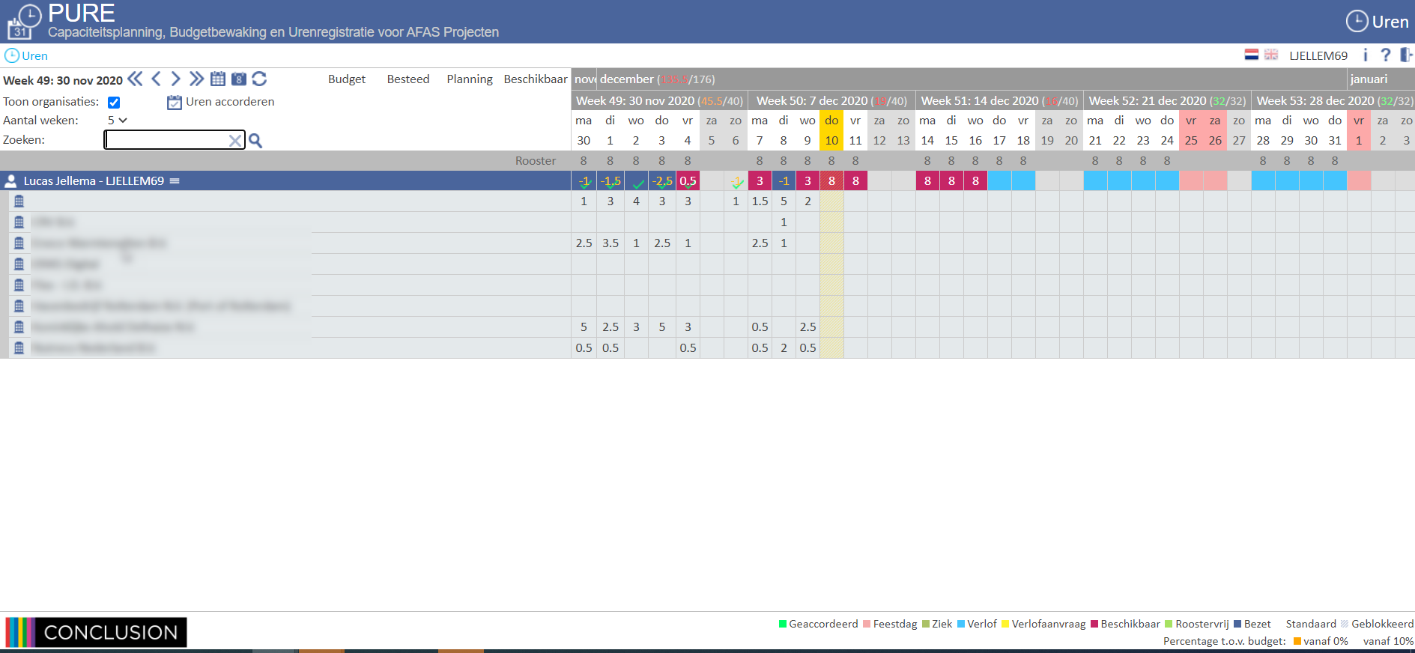
Demo – Timesheet Deeplink Bookmark
Manually
Deeplink Bookmark
Open browser
Navigate to page
Login
<MFA approval on mobile phone>
Confirm popup
Click on navigation button
<new frame opens>
Click on navigation button
<timesheet opens>
Expand Project
<wait>
Expand Project
<wait>
…
Start entering hours
Click on Shortcut
<MFA approval on mobile phone>
<wait>
Start entering hours

Slide 9
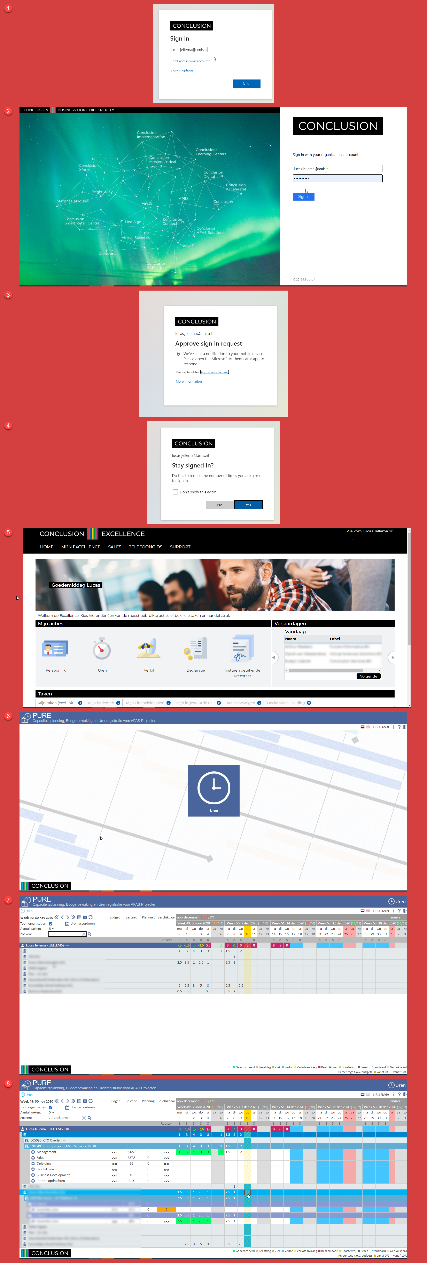

Deep Link Bookmark – Under the Hood

Slide 10
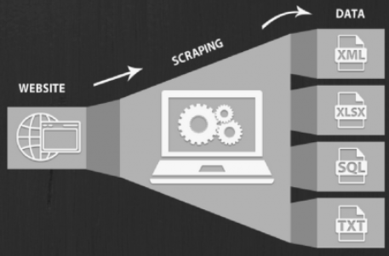
Data gathering from Web Sites and Web Applications

Slide 11
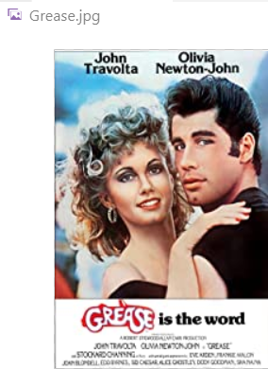
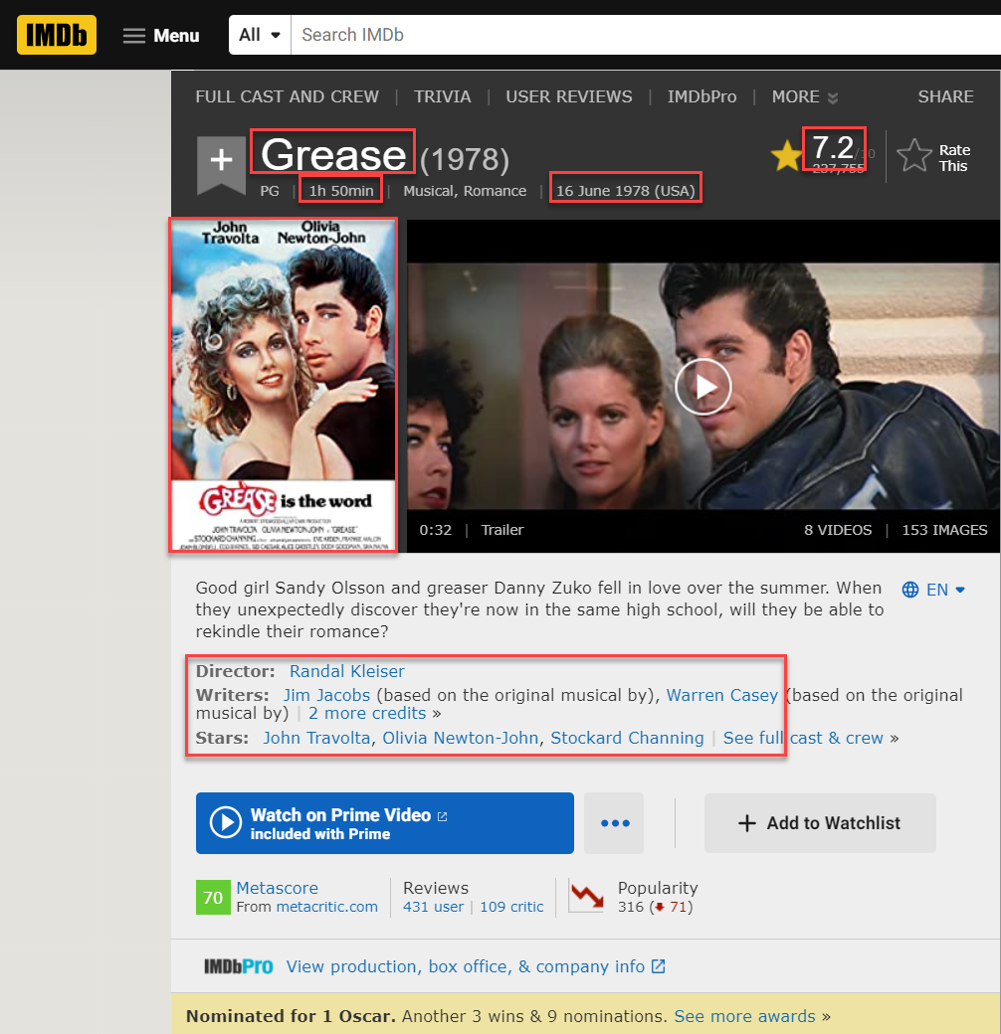

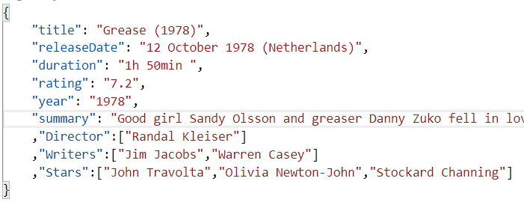
Programmatic IMDb Data Scraping
Web Application
REAL Toolshed | December 2020 | Playwright browser automation

Slide 12

UI as API
Web Application
API

Slide 13
UI as API
Web Application
API

Slide 14
Google Translate UI published as API
Translation API to easily translate a text from source to target language
Web Application
API

Slide 15
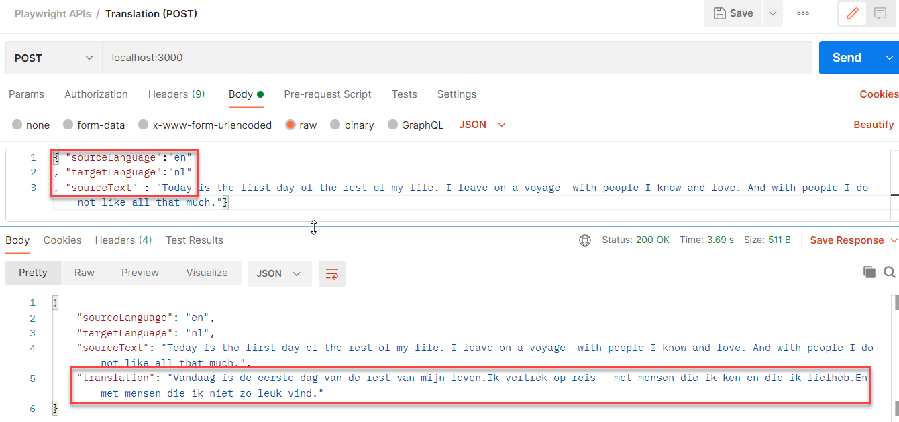
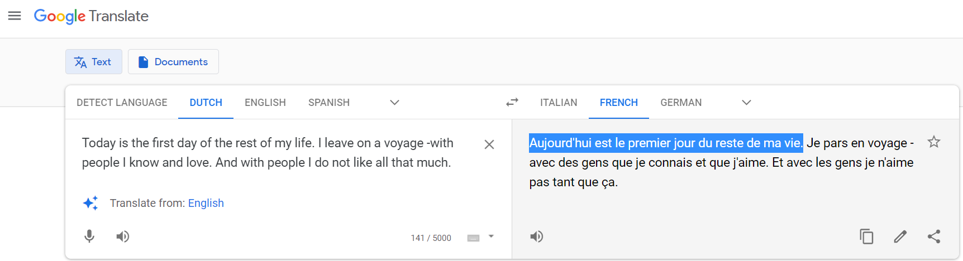
Google Translate UI published as API
Web Application
API

Slide 16

WhatsAPI
API

Slide 17
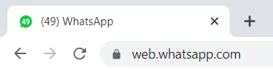
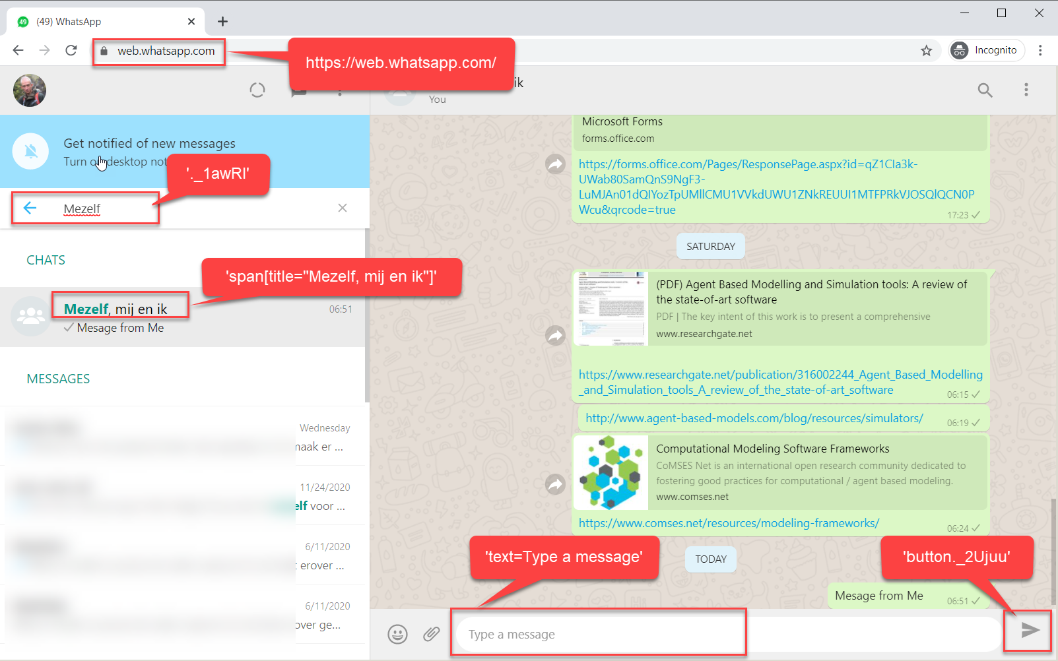
Programmatic interaction with WhatsApp
send message to contact
Web Application
API

Slide 19
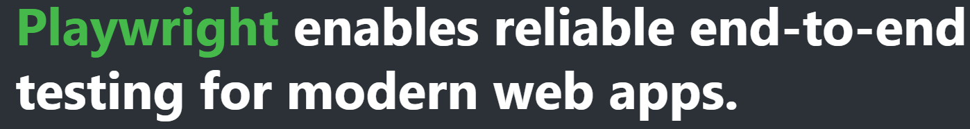
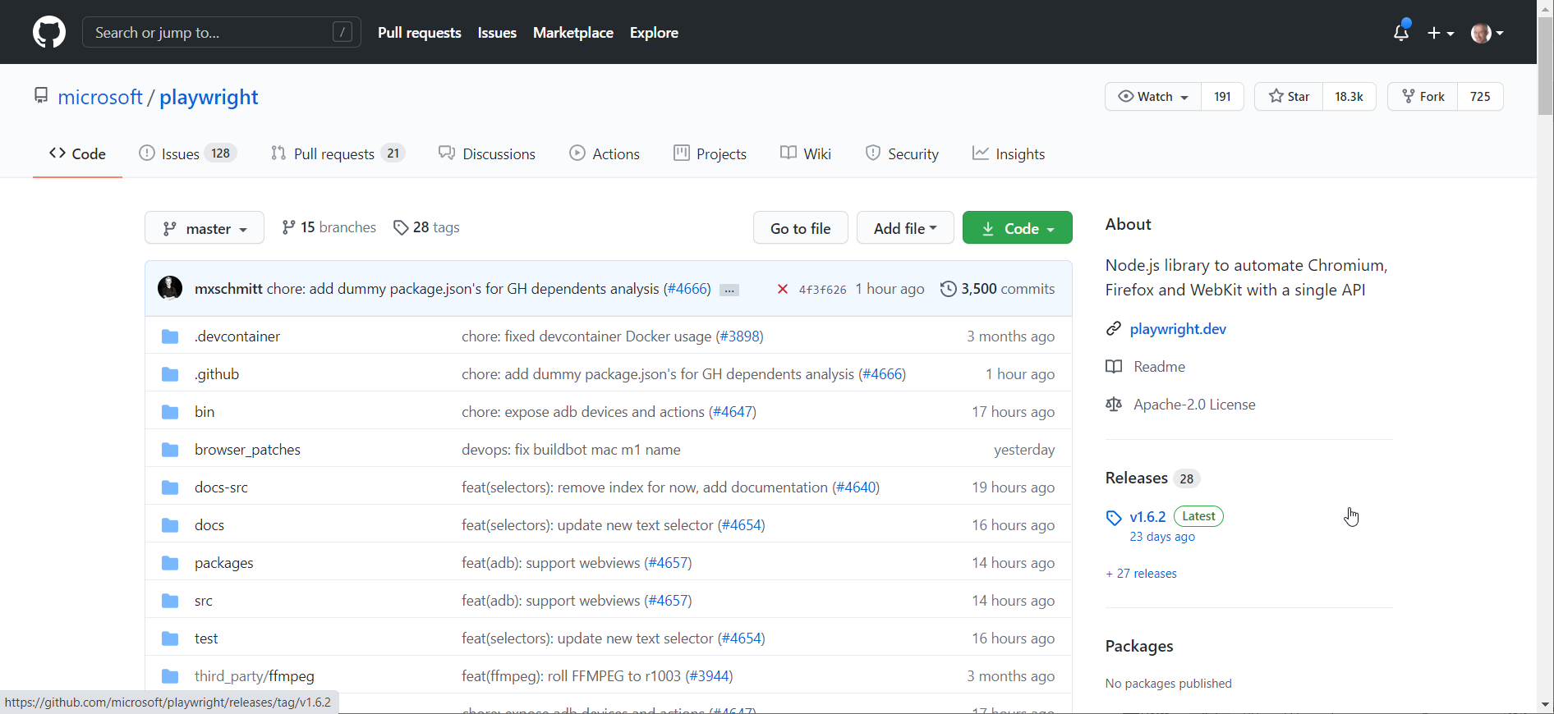
Overview of Playwright
Make the browser do anything a user can make the browser do plus everything a developer injecting JavaScript into a live session can activate
First release January 2020
1.0 in May, 1.7 in December
By Microsoft - the team that first created Puppeteer (while working at Google)
Open Source – on GitHub
Support for Chromium, Firefox and WebKit
Is an alternative to WebDriver
Primary use case: Web UI Test Automation

Slide 20
Playwright
HTTP Requests to fetch HTML, CSS, JS, images, JSON, SVG, XML, SSE, files, …
Third Party SaaS
BI Dashboard
Cloud Portal/Console
Custom Application
(web UI on) FTP site
Public Website
Intranet
My Custom Application
Web Application
HTTP Requests to post data, upload files, …
DOM, JavaScript context, web workers, local storage, cookies,

Slide 21

Playwright – embedded, fully controlled browser
API Calls/HTTP Requests to fetch HTML, CSS, JS, images, JSON, SVG, XML, SSE, files, …
Read DOM elements, fill in fields, click buttons, trigger events, manipulate/add DOM elements, add and execute JavaScript
My Custom Application
Web Application
HTTP Requests to post data, upload files, …
DOM, JavaScript context, web workers, local storage, cookies,

Slide 22
Playwright – embedded, fully controlled browser
API Calls/HTTP Requests to fetch HTML, CSS, JS, images, JSON, SVG, XML, SSE, files, …
Read DOM elements, fill in fields, click buttons, trigger events, manipulate/add DOM elements, add and execute JavaScript
Intercept/Mock HTTP Requests and WebSocket channels, Make additional Requests
My Custom Application
Backend / API
Web Application
HTTP Requests to post data, upload files, …
DOM, JavaScript context, web workers, local storage, cookies,

Slide 23
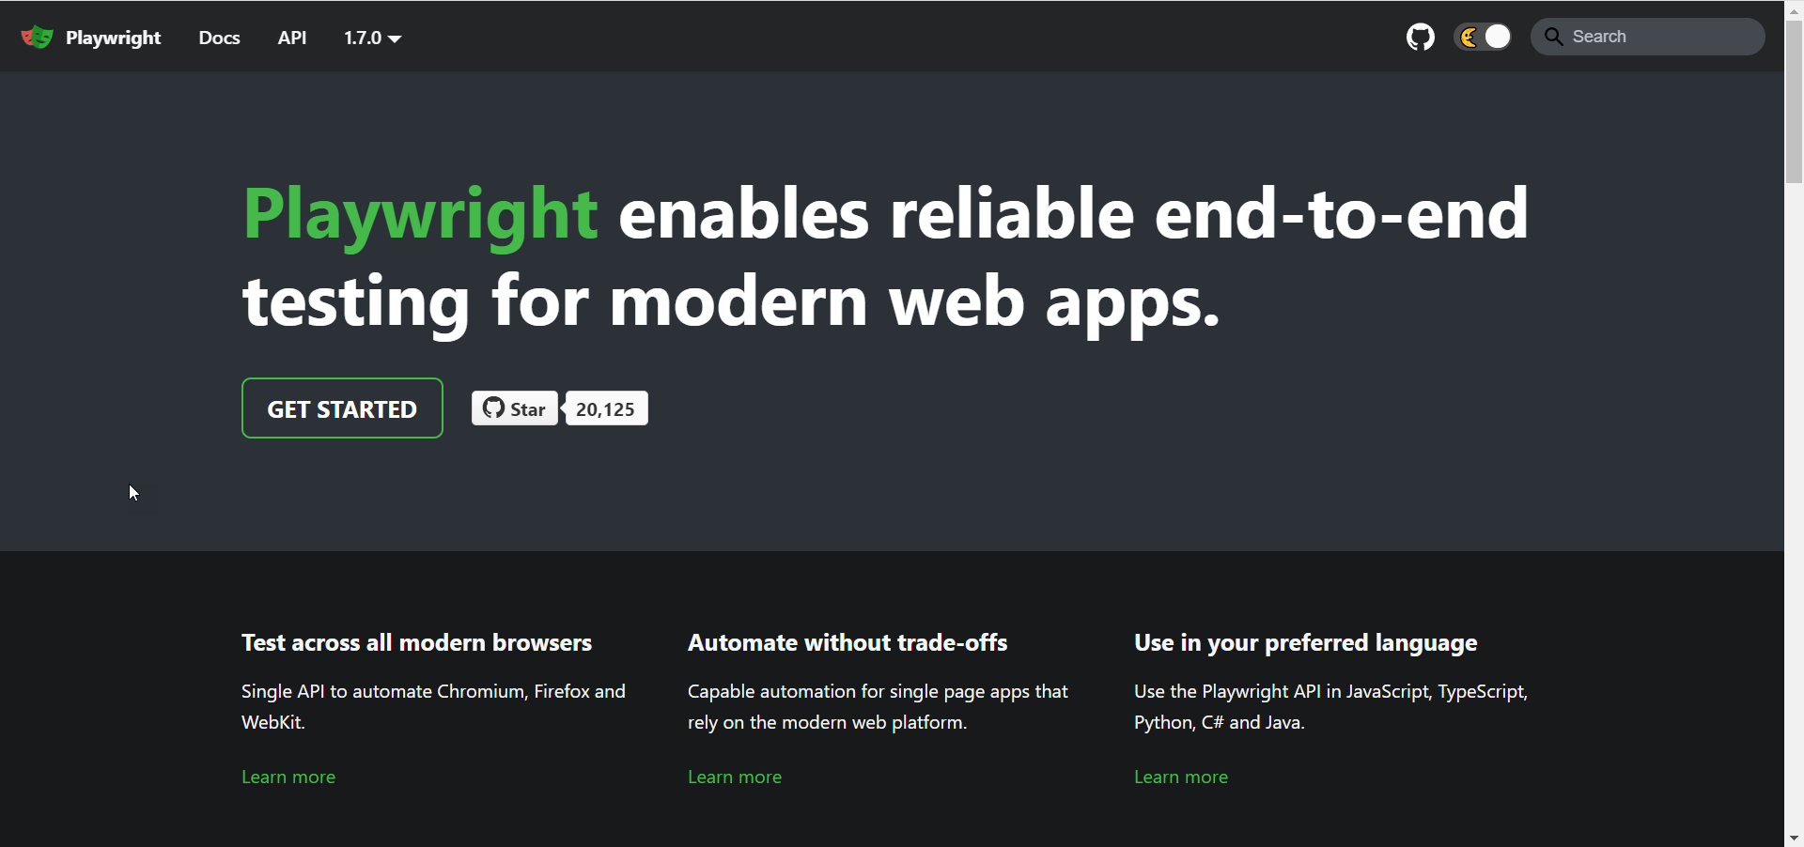
Overview of Playwright
The Playwright API is available for
JavaScript and TypeScript
Python
C#
Go
Java
Homepage: playwright.dev
Docker Container for running Playwright scripts: mcr.microsoft.com/playwright:bionic

Slide 24
Some Playwright Features
Headless and Headful
Bi-directional JavaScript interaction: from Node to Browser and from Browser to Node context (for example: write to console within the browser or in Node)
Integration with debugging tools
Full control across popups, multiple frames and pages (i.e. browser tabs)
Download and Upload Files
Get images (and write to file)
Create Screenshots (.png) and PDF
Record Playwright Session as Video (MP4)
Access to WebPerformance APIs
Social Login (Google, Microsoft Live)
but not 2FA or Captcha
Read and Set Cookies and Local Storage, interact with Web Workers,
Manipulating network requests (HTTP requests sent from the page)
Headless Recorder (CLI, browser plugin and QA Wolf) to record Playwright script
Playwright Test Runner and integration with other Test Runner (Mocha, Jest, Jasmine)
Notes:
https://dev.to/mxschmitt/using-jest-with-playwright-40lh

Slide 25
Many Opportunities Open Up
Deeplink Bookmarks
UI Test automation
including visual regression (use Resemble.js, pixelmatch, Rembrandt.js)
behavior driven testing, performance & load testing
Tactical integration
automation of data retrieval (“Screen Scraping”) and data entry
Health Checks (monitoring of User Interfaces)
Automated Reporting
Customized Web Application
UI turned API
Demos and [step by step] Instructions
RPA – Robotic Process Automation
automated workflow across multiple systems
possibly a collaboration between human & robot
Prototyping (try out finetuning running webapp)

Slide 26
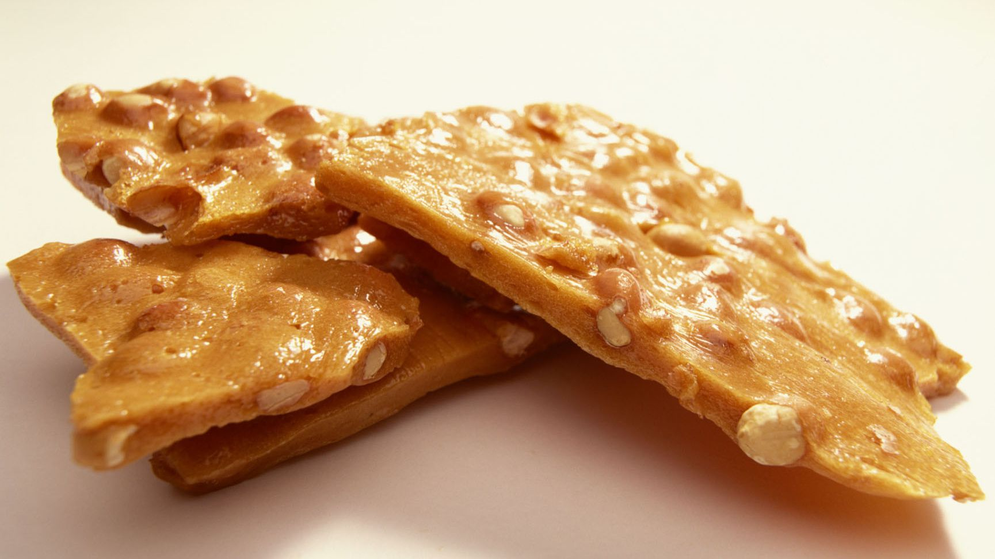
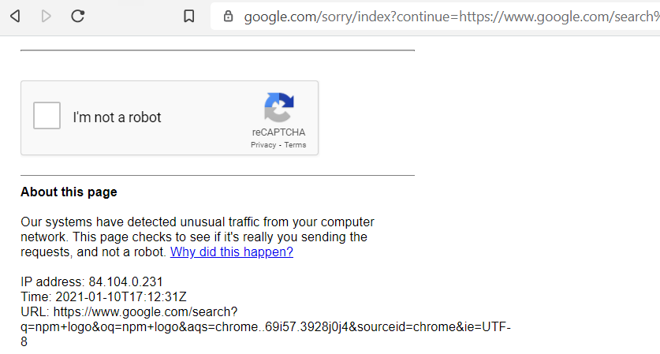
Brittle Ethics
Humans are somewhat flexible with respect to changes in a User Interface
and do not rely on CSS classes and HTML identifiers
A Web Application’s user interface(‘s technical implementation) is not a formal contract such as a REST API
Changes can occur in the User Interface that may throw the API implementation created with Playwright
Ethical considerations: a user interface is not intended for heavy programmatic use
use caching and other means to limit the load on the underlying web site

Slide 27
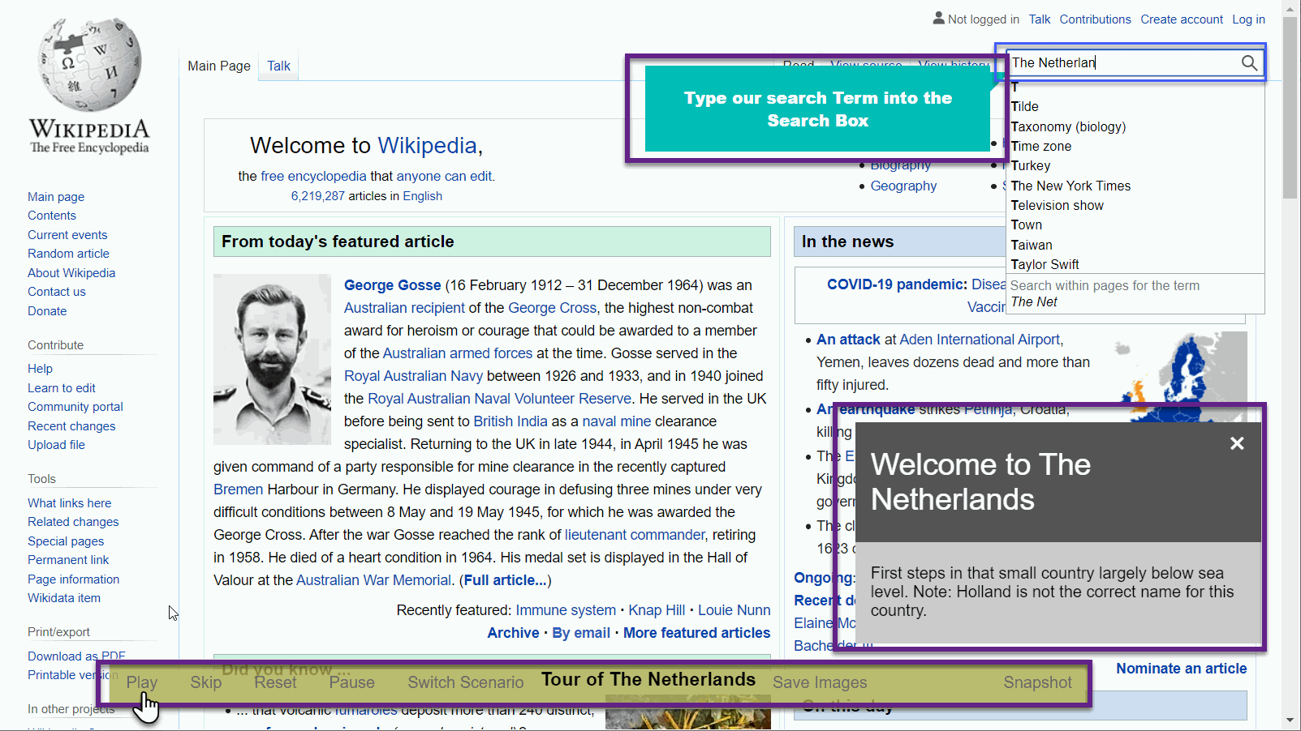
Play step-by-step headful Playwright Scenario Acts To instruct, demonstrate, collaborate or accelerate
A Playwright scenario in a headful browser can be used to
demonstrate actions in a web site or app
provide a tutorial or hands-on instruction on the site or app
perform quick actions on behalf of the user in a web site or app
create a combined human ⬄ machine workflow
Playwright script sections (command bundles) can be played on demand
with annotation
conditionally
lightning fast or at human interpretation speed

Slide 28
Playwright scenarios – tutorial | demo | documentation | …
Scenario
Play Act
Switch
Pause
Reset
Features
Callout
In Situ Balloon
Type text
Highlight text
Scroll elements in view
Hover over elements
Open new tab / Switch between tabs

Slide 29

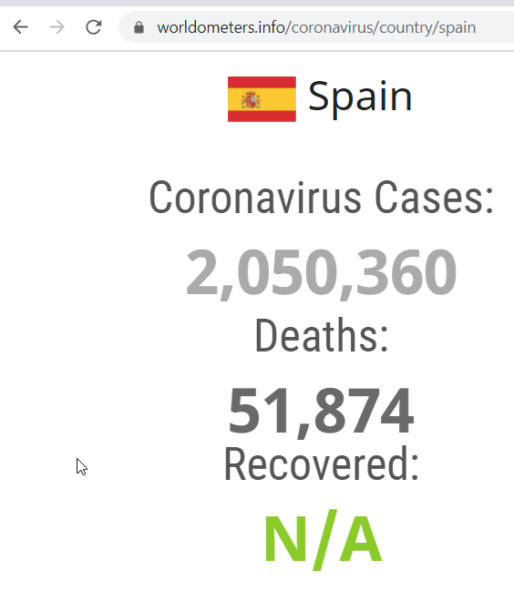

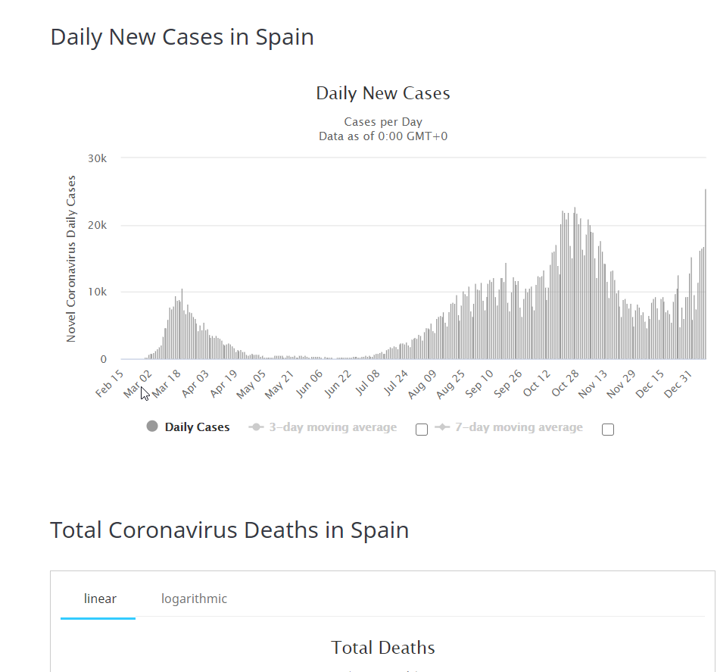
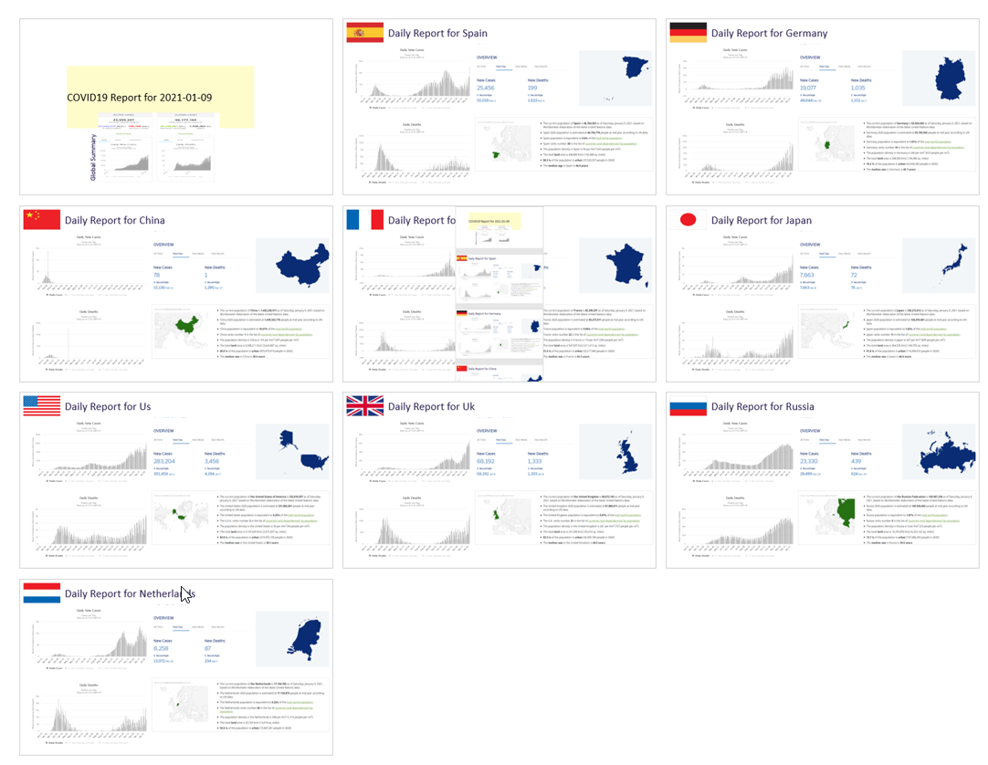
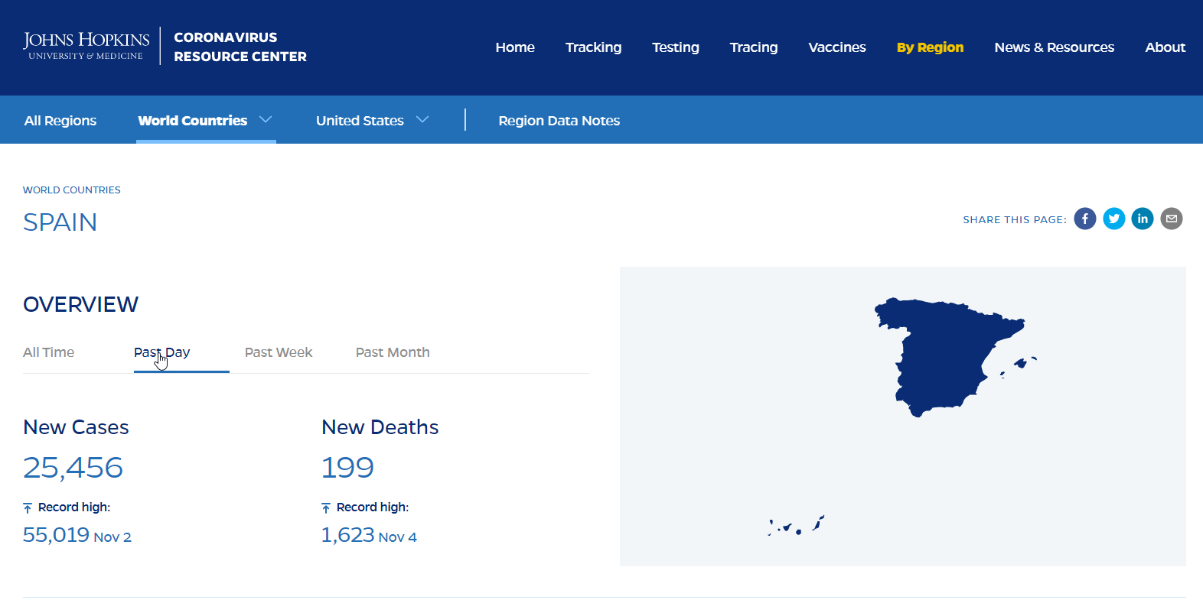

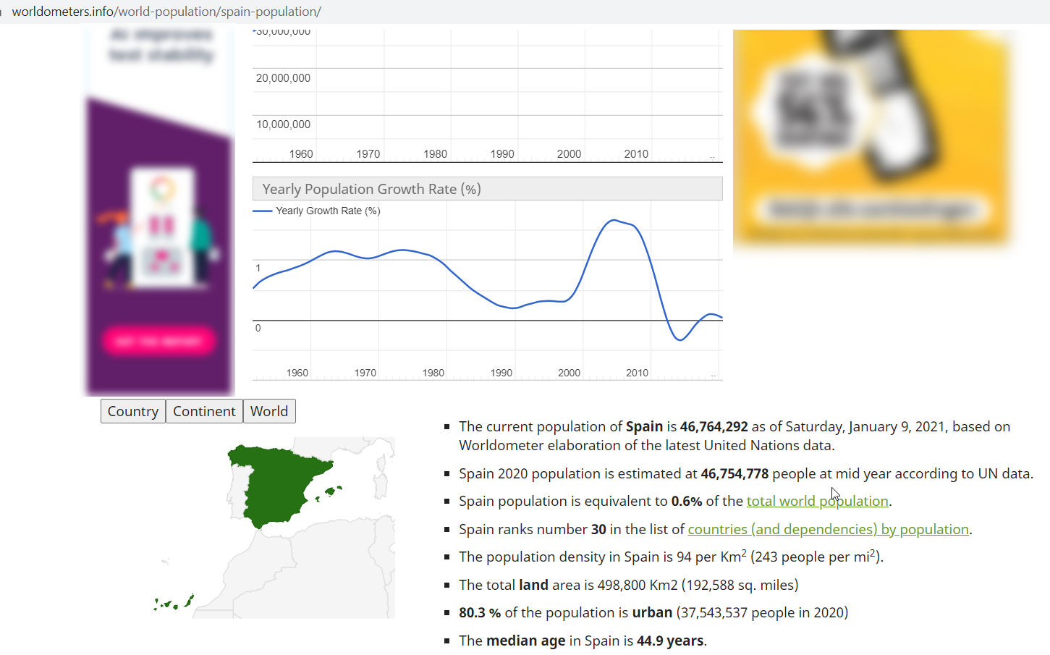


Generate Daily COVID-19 PowerPoint report
Web Application
function
npm module PptxGenJS
npm module svg2img
npm module Jimp

Slide 30

How?
Program Code

Slide 31
Hello World of Playwright Demos
//navigate to http://whatsmyuseragent.org and take a screenshot.
const { chromium } = require('playwright’);
(async () => {
// start headless embedded browser
const browser = await chromium.launch({headless: true});
const page = await browser.newPage();
// navigate to thesite
await page.goto('http://whatsmyuseragent.org/');
await page.screenshot({ path: `myuseragent-snap.png` });
await browser.close();
})();

Slide 32

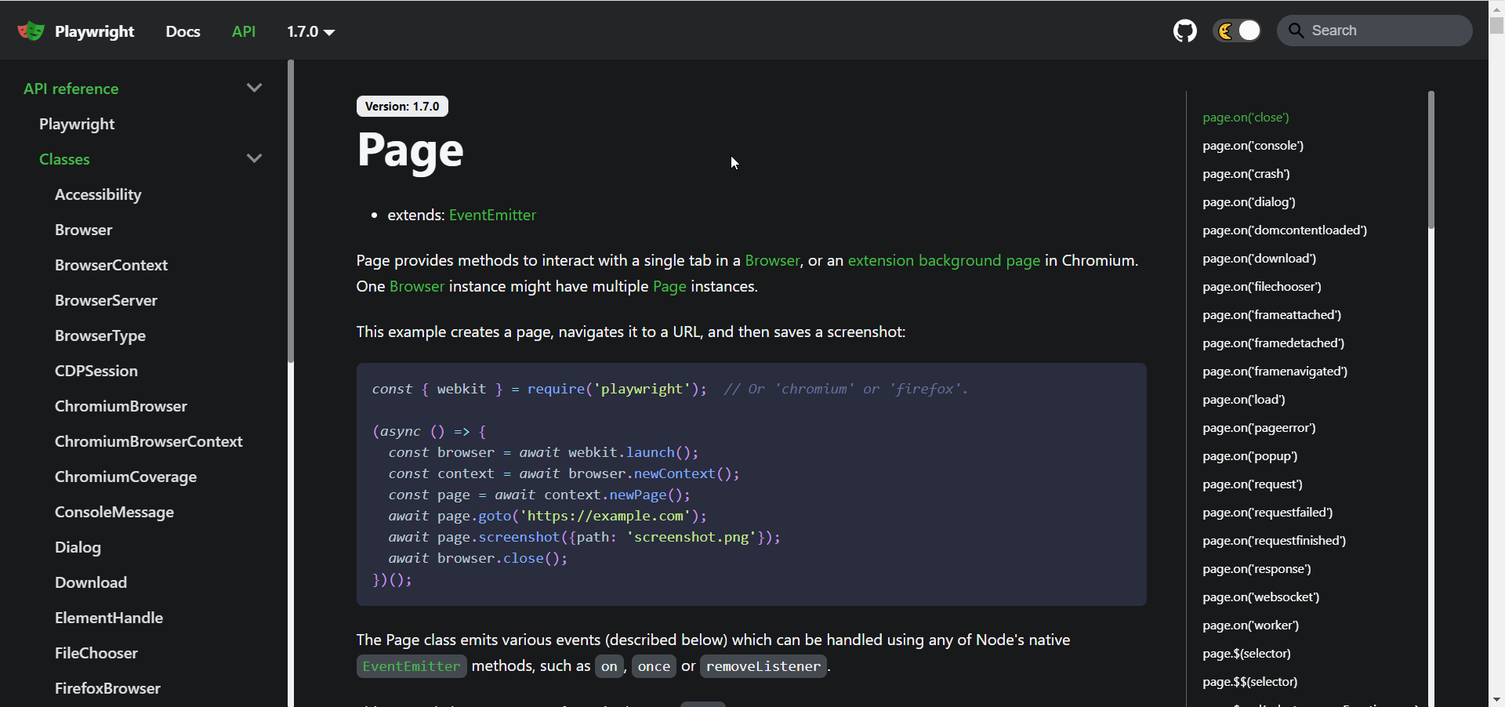
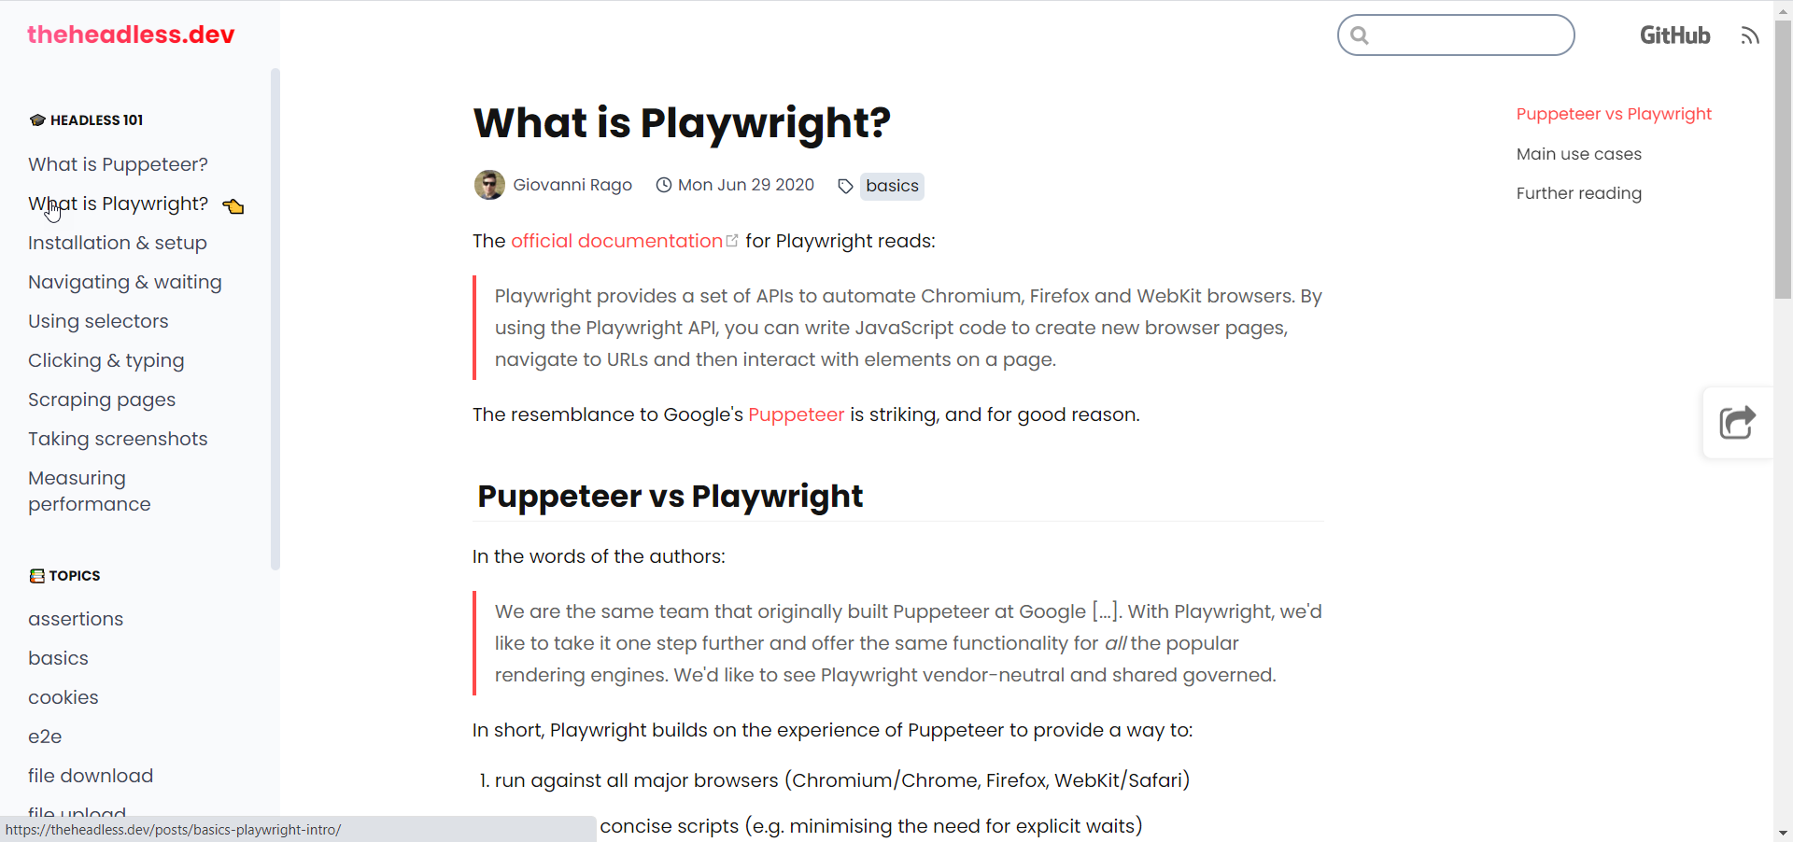
Playwright Resources
Home-page: https://playwright.dev/
API docs
Headless Testing & - theheadless.dev/ - headlesstesting.com/support/start/playwright.html

Slide 33
Google Translate UI published as API
'textarea'
'.VIiyi > span > span'
Web Application
API

Slide 34
Demo of Translation API (powered by Google Translate)
const translate = async (sourceText, sourceLanguage, targetLanguage) => {
const browser = await chromium.launch({ headless: true })
const context = await browser.newContext()
const page = await context.newPage()
await page.goto(`https://translate.google.com/?sl=${sourceLanguage}&tl=${targetLanguage}`)
await page.waitForSelector('textarea')
}
‘textarea’
‘.VIiyi > span > span’

Slide 35
Demo of Translation API (powered by Google Translate)
const translate = async (sourceText, sourceLanguage, targetLanguage) => {
const browser = await chromium.launch({ headless: true })
const context = await browser.newContext()
const page = await context.newPage()
await page.goto(`https://translate.google.com/?sl=${sourceLanguage}&tl=${targetLanguage}`)
await page.waitForSelector('textarea')
// set text to translate in the source textarea; note: if length of sourceText > 5000, // then we should process the sourceText in multiple (parallel processed) slices
await page.fill('textarea', sourceText);
// give Google Translate a little time to perform the translation
await sleep(800)
// get translations from target area (which consists of one or more spans): '.VIiyi > span > span'
const translatedLines = await page.$$eval(".VIiyi > span > span", (spans) => {
return spans.map(span => span.innerText); });
// concatenate the individual lines to a single string
const translation = translatedLines.reduce((accumulator, line) => accumulator + line)
await browser.close()
return translation
}

Slide 36
Selector
Interaction with forms, fields, buttons, links, text areas, headings, images, …
actions: read content, fill, type, hover, click (& double click), scroll into view, wait for, tap
Selectors are expressions to locate, manipulate or get a handle on a page element
Types of selectors:
text: page.click('text=Login')
css: const buttonHandle = page.$('span.submit > button')
xpath: const title = page.textContent('xpath=//html/body/h1[0]')
Selectors “pierce” open shadow DOM – for WebComponents – but not iframes
Selectors can return multiple elements
operations act on first
page.$$ returns an array of all matching DOM elements

Slide 37
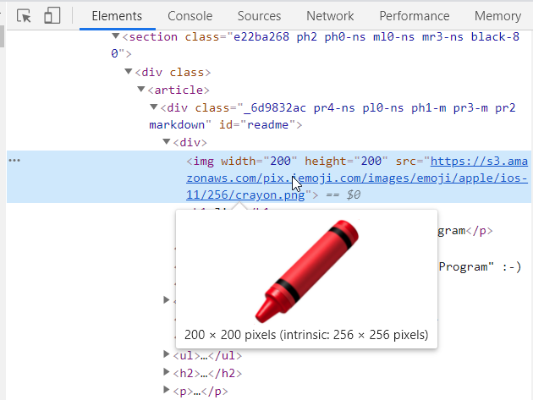
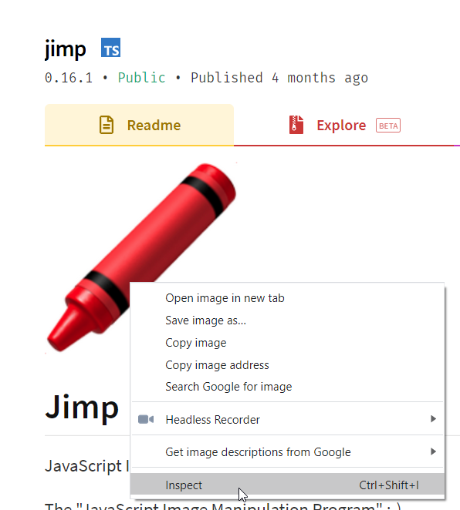
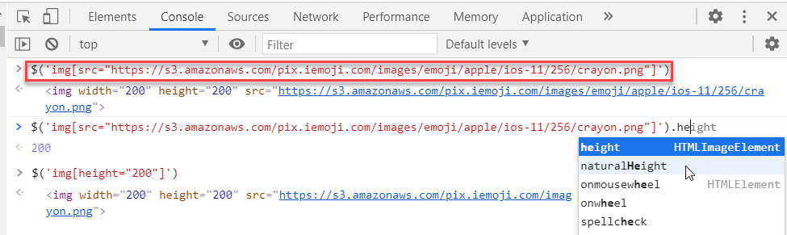
Locating DOM Elements
CTRL + Shift + I – Browser Developer Tools
Inspect
Console: $(‘selector’)

Slide 38
Two JavaScript Contexts
2-way bridge
full access to DOM, JavaScript context,
Web APIs, AJAX/WebSocket network calls leverage browser session’s authentication status
add/change/remove DOM elements
handle events
publish events on DOM elements
invoke JavaScript functions
full access to file system, NPM modules, network, database, …
No direct access to browser DOM and JS context

Slide 39

Add Short Cut Key to Web Application Example: take snapshot of the current page for CTRL+y
Add keyup event listener to invoke this proxy when the shortcut key (ctrl + y) is pressed
Web Application
function snapshotter
function handleShortCutKey
document.addEventListener ('keyup', handleShortCutKey)
function snapshotterFunction
This function is handed a Playwright source object that contains a reference to the page object. The screenshot() function on this object is invoked to write a PNG file with a snapshot of the current browser’s page content
.png
Expose NodeJS function as JavaScript function [proxy] in the browser context of the web page

Slide 40
Inject shortcut key for downloading all images into page
let snapshotCount = 0
const snapshotter = async (source) => {
await source.page.screenshot({ path: `${SNAPSHOT_PATH}pageSnapshot${snapshotCount++}.png` });
}
// create a shortcut key (ctrl + b) that triggers the JS function to download all images
const shortCutJS = `async function handleShortCutKey(e) { if ('KeyY'==e.code && e.ctrlKey) {
window.snapshotFunction() ; }}
document.addEventListener('keyup', handleShortCutKey);
`
(async () => {
const browser = await chromium.launch({ headless: false })
const context = await browser.newContext()
// expose a Node function as binding to the page (to be invoked from the function)
await context.exposeBinding('snapshotFunction', snapshotter)
// execute JS snippet for every new page, page reload and navigation await await context.addInitScript ({ content: shortCutJS })
const page = await context.newPage(); await page.goto(URL);
... // at this point, the browser will respond to ctrl+y by invoking handleShortCutKey // that in turn invokes window.snapshotFunction() which is a proxy for function snapshotter in // the context of the Node application that will write a snapshot PNG file

Slide 41
Manipulate Web Page from Node application
Add JavaScript to execute for each page load, refresh, navigation
context.addInitScript(<browser side JavaScript>)
Add <script> tag to page – with new JavaScript functions and statements to execute
page.addScriptTag({ content: `console.log('Message from the Outside')` })
Expose NodeJS function inside the Browser context (on the window object)
context.exposeBinding('nameOfWindowProperty’, nodeJSFunction)
Add <style> tag to page - with CSS definitions
page.addStyleTag({ content: `h1 { color:red}`})
Execute JavaScript snippet in the Browser context of the web page
page.evaluate( (name) => { console.log(`name from NodeJS: ${name}`) }, myName)
Execute JS snippet for a DOM Element located by Playwright (this hides the toolbar)
page.$eval('#TOOLBAR_ID', (toolbar) => { toolbar.style.display = "none"; })

Slide 42
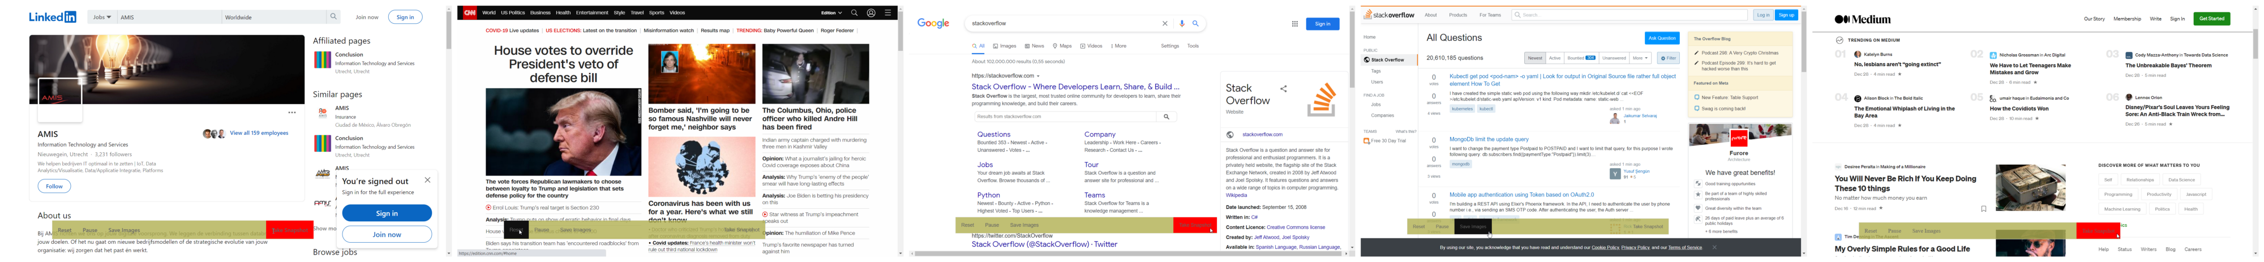

Inject Toolbar into any Web Page or Site loaded into Playwright embedded browser
Add floating toolbar with menu options to page after loading or refreshing
toolbar can be toggled on or off with shortcut key
options include Save all Images in page (to local file) and take Snapshot of page
github.com/lucasjellema/playwright-scenarios/tree/main/floating_menu

Slide 43
Implementation challenges
Create a floating, fixed, semi-transparent toolbar — using HTML and CSS
Add this toolbar — using Playwright — on top of a site or app that is loaded into the embedded browser
and ensure that the toolbar stays around / is added again whenever the browser is navigated to a new page
Implement the Snapshot function linked to a toolbar option: when the option is triggered, the Playwright function for taking a snapshot of the page is activated.
note: the toolbar itself should be hidden at the time of taking the snapshot
Show and hide the toolbar using a short cut key combination
Add a toolbar option for saving all images in a page
Add other features to the toolbar that make life easier around specific or generic web sites and web applications
save/restore form entries, record currently selected text, remove all images from page, play a specific Playwright scenario (demo, instruction, shortcut), ...
Notes:
https://github.com/lucasjellema/playwright-scenarios/tree/main/floating_menu

Slide 44
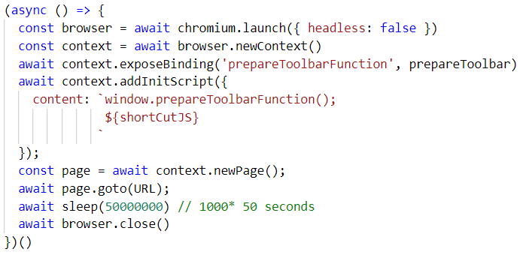
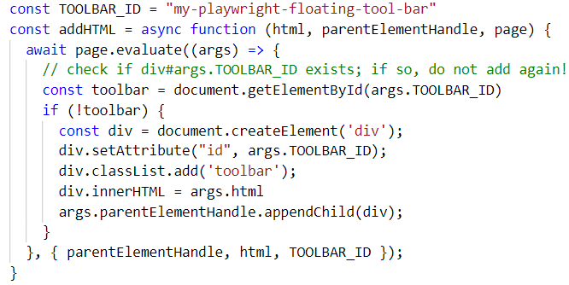
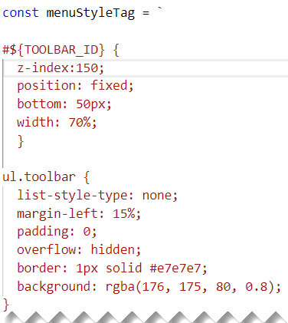
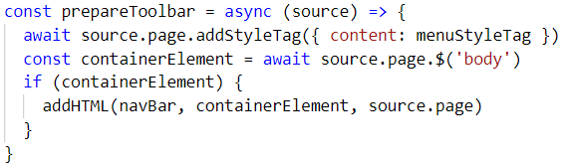
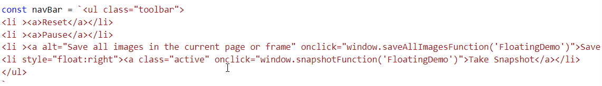

Slide 45
Playwright enables these operations in the Browser Context
Read and Write (& initialize) Cookies
Work with Persistent Context (user data directory) in MFA scenarios
Read and Write (& initialize) Local storage
Set HTTP Credentials for HTTP Authentication
Read and Set Locale & Timezone
Set and Get Geolocation
Define Viewport (dimensions of visible area) – for browser context or page
Set Mobile Device – to simulate browser behavior on a mobile device
Define User Agent (header used in HTTP requests)
Web Worker (not Service Worker) – monitor and delegate work to
Monitor, Modify, Abort and Fulfill (aka Mock) HTTP Network requests
Monitor WebSocket events
replace WebSocket class with custom class through addInitScript() to mock WebSocket traffic
Monitor all page events using page.on(‘event’) handlers
console, dialog, load, fileChoooser, popup, request, response, domcontentloaded, close

Slide 46
Testing and Testability of Web Applications
When using Playwright for automating the test of our custom web application, we can consider enhancing the testability of our application:
fixed, meaningful element identifiers and CSS class names
client-side logic in stand alone JavaScript functions (that do not interact with DOM)
have functions that set a value on a DOM element also return the value(s) they set
Testing with Playwright
one browser (“heavy object”), multiple contexts & multiple pages (light weight objects)
prepared cookies, local storage, persistent context
execute JavaScript snippet in browser context to quickly initialize page context (set field values, execute AJAX calls) instead of corresponding UI manipulation
take screenshot and make movie during test (and remove when the test succeeds)
an element handle represents a DOM element and can be inspected for properties
to speed up, collect “multiple assert findings” in a single object that is evaluated
instead of running separate Playwright tests for every assert

Slide 47
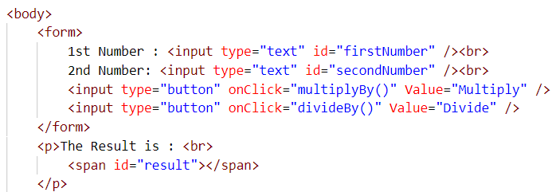
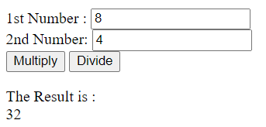
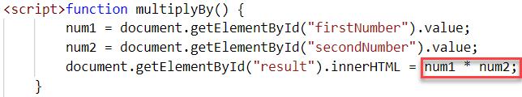
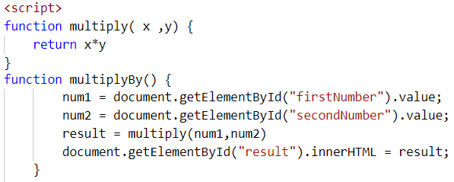
Example of Enhancing Testability
Mix logic with UI/DOM interaction
Split logic from UI/DOM interaction

Slide 48
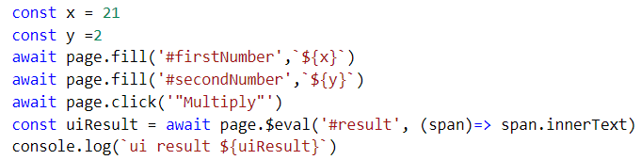
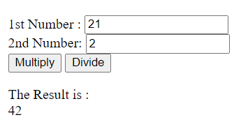

Slide 49

Hands On
Workshop: bit.ly/pw-14jan

Slide 50
Hands On
Workshop: bit.ly/pw-14jan

Slide 51



1. Installation
In any environment
Install NodeJS and NPM runtime
Install Playwright (npm install –D playwright)
git clone meetup repository from GitHub
or on Windows 10 with Sandbox enabled
simple steps to create fresh, isolated and proven hands on environment
follow instructions in technology.amis.nl/languages/node-js /quickly-run-nodejs-demos-in-vanilla- windows-sandbox-featuring-scoop/
Workshop: bit.ly/pw-14jan

Slide 52

2. Run Provided Demonstrations
inspect and tweak sources
demos provided
Quick Steps
single page, multi tab | window, take screenshot, generate MP4 | PDF
Scrape IMDb
API-fy Google Translate
Inject Short Cuts
Inject Floating Toolbar
Step-by-Step tutorials | demonstrations
PowerPoint Generator
Workshop: bit.ly/pw-14jan

Slide 53
3. Playwright from Scratch – by you
Create a fresh NodeJS Application
Copy and paste code to create a browser and a page and load a website in the browser
Add code to interact with the website: click, scroll, scrape
Add code to manipulate the page:
execute JavaScript in the browser and replace content in the DOM
Add code to open a second website in a new browser tab
Search in the second website
Assert several conditions – as a first basic test
Workshop: bit.ly/pw-14jan

